Slide 1
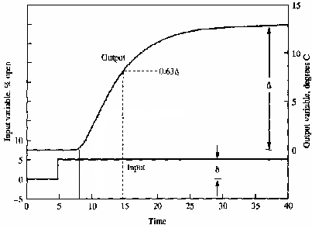
Fundamentals
when times greater than the time delay
steady-state gain
Time Constant τ
Time Delay L:

Slide 2
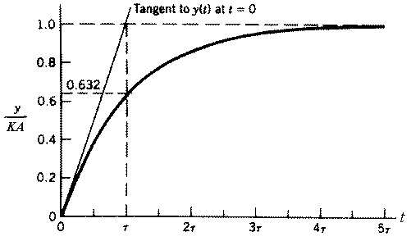
Graphic Method
steady-state gain
Time Constant
Deepest Slop

Slide 3
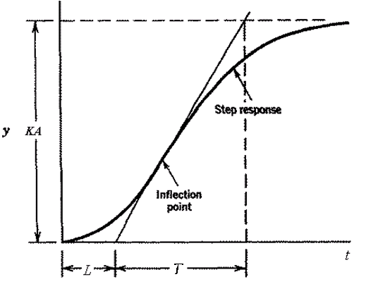
Graphic Method
when times greater than the time delay
steady-state gain
Time Constant
Time Delay L:

Slide 4
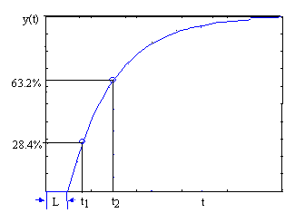
Two Points Method
Process model and step response, when
y(∞)%
28.4
39.3
55
59.3
63.2
77.7
86.5
time(t)
T/3+L
T/2+L
0.8T+L
0.9T+L
T+L
1.5T+L
2T+L
t₁ and t₂, the time when response with value 28.4% and 63.2%
t₁= T/3+L
t₂=T+L

Slide 5
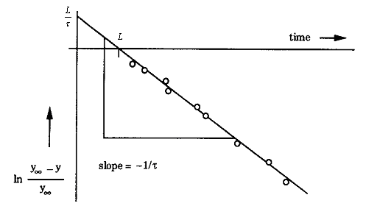
Log Method
First order process when times greater than the time delay
estimate of the steady-state gain
Time Constant τ and Time Delay L:
Plot against t: a straight line with
slope of -1 /τ,
intercept y-axis at L /τ.
meet the t-axis at the point t = L.
estimates of parameters graphically.

Slide 6
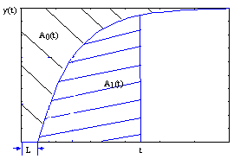
Area Method
Average residence time T_{ar} computed form the area of A₀
Measure and compute area A₁ under step up to the time T_{ar}
T and L can be estimated as

Slide 7
FOPTD Process
For
Define
For N samples

